Slide 1
UNIT 1
Introduction to Data Structure and algorithms:

Slide 2
Data Types
The data type of a value or a variable is an attribute that tells what kind of that value can have. Date types include the storage classification like integers, point values, stings, characters etc. Each variable has an associated data types. Each data types required different amounts of memory and has some specific operations which can be performed over it.
A) Basic data types: The data types that are pre-defined are immediately available to users by the compiler which programming are basic data types. Some of the basic data types are as follows:-
1) Integers : It is a data type used to store integer values. If the floating point numbers are tried to store in this data type then it can not store floating numbers. It will terminate or escape numbers after the decimal point and will only store fractional values.

Slide 3
Data Types
2) Character It stores a single character and requires a single byte of memory in almost all compilers.
3) Float It is used to store decimal numbers with single precision. It takes 4-byte memory space.
4) Double It is used to store decimal numbers with double precision. It takes 8-byte memory space.

Slide 4
Data Types
B) User-defined types: The data types that are defined by the user in the program are called derived data types or user-defined data types. Following are some of the user-defined data types:
1) Class: The user-defined data types that hold data members and member functions are called classes. A class can be accessed and used by creating an object of the class.
2) Structure: A structure is a user-defined data type in c/c++. A structure created a data type that can be used to group items of possibly different types into a single type.
3) Union: Union is a user-defined data type similar to structure. In union, all members share the same memory location.
4) Enumeration: Enumeration (or enum) is a user-defined data type in c. it is mainly used to assign names to integral constants, the names make the program easy to read and maintain.

Slide 5
Data Structure
Data structure is a way of collecting and organizing data in such a way that we can perform operations on these data in an effective way. Data structure is about rendering data elements in terms of some relationship, for better organization and storage. For example:- Let us have some data which has the student’s name ‘Ramesh’ and age 24. Here ‘Ramesh’ is of integer data type. We can organize this data as a record like a student’s record, which will have both name and age in it. Now we can collect and store students’ records in a data as a data structure.
In simple language, data structures are structures programmed to store ordered data, so that various operations can be performed on it easily. It represents the knowledge of data to be organized in memory. It should be designed and implemented in such a way that it reduces the complexity and increases the efficiency. Algorithm + Data Structure = Program

Slide 6
Data Structure
Uses of data structure:
1) Data structure is used to reduce complexity of programs.
2) It is used to increase efficiency of programs.
3) Data structures as a framework for organizing and storing information in virtual memory forms.
4) It prevents data collision by elimination ambiguous data.
5) It is used to arrange the data in an efficient and effective manner.

Slide 7
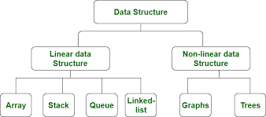
Data Structure

Slide 8
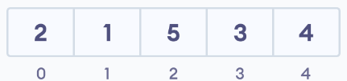
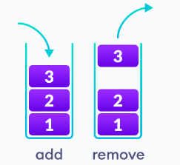
Linear Data Structure
Linear data structures
In linear data structures, the elements are arranged in sequence one after the other. Since elements are arranged in a particular order, they are easy to implement. However, the linear data structures might not be the best choice when the program's complexity increases because of operational complexities. Linear data structures are further divided into array, stack, and queue.
Array Data Structure
In an array, elements in memory are arranged in continuous memory. All the elements of an array are of the same type. And, the type of elements that can be stored in the form of arrays is determined by the programming language.
Stack Data Structure
In the stack data structure, elements are stored in the LIFO principle. That is, the last element stored in a stack will be removed first

Slide 9
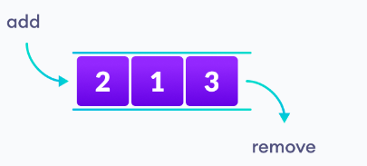
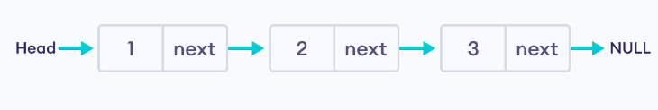
Linear Data Structure
3. Queue Data Structure
Unlike stack, the queue data structure works in the FIFO principle where the first element stored in the queue will be removed first.
4. Linked List Data Structure
In linked list data structure, data elements are connected through a series of nodes. And, each node contains the data items and addresses to the next node.

Slide 10
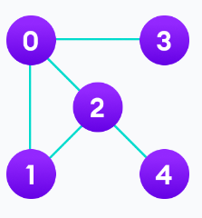
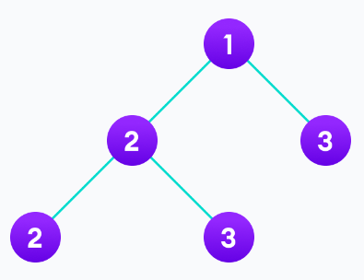
Non-Linear Data Structure
Non-linear data structures
Unlike linear data structures, elements in non-linear data structures are not in any sequence. Instead, they are arranged in a hierarchical manner where one element will be connected to one or more elements. Non-linear data structures are further divided into graph and tree-based data structures.
1. Graph Data Structure
In graph data structure, each node is called vertex and each vertex is connected to other vertices through edges.
2. Trees Data Structure
Similar to a graph, a tree is also a collection of vertices and edges. However, in the tree data structure, there can only be one edge between two vertices.

Slide 11
Linear Vs Non-linear Data Structures
Linear Data Structures | Non Linear Data Structures
The data items are arranged in sequential order, one after the other. | The data items are arranged in non-sequential order (hierarchical manner).
All the items are present on the single layer. | The data items are present at different layers.
It can be traversed on a single run. That is, if we start from the first element, we can traverse all the elements sequentially in a single pass. | It requires multiple runs. That is, if we start from the first element it might not be possible to traverse all the elements in a single pass.
The memory utilization is not efficient. | Different structures utilize memory in different efficient ways depending on the need.
The time complexity increase with the data size. | Time complexity remains the same.
Example: Arrays, Stack, Queue | Example: Tree, Graph, Map

Slide 12
Abstract Data Types(ADTs)
Definition Abstract data type (ADT) is a type or a class for objects whose behavior is defined by a set of value and a set of operations. It does not specify how data will be organized in the memory and what algorithms will be used for implementing the operations.
Uses:-
1) ADTs are used in the design and analysis of algorithms, data structures and software systems.
2) It provides concept for data abstraction and data hiding.

Slide 13
Abstract Data Types(ADTs)
Advantages/ Benefits of using ADTs:
1) Modularity
2) Precise specifications
3) Information hiding
4) Simplicity
5) Integrity
6) Implementation independence

Slide 14
Static Vs Dynamic Memory Allocation
Static Memory Allocation | Dynamic Memory Allocation
Allocation is done before the program’s execution. | Allocation is done during the program’s execution
There is no memory reusability and the memory allocated cannot be free. | There is memory reusability and the allocated memory can be freed when not required
Less efficient | More efficient

Slide 15
Concept of Dynamic Memory Allocation
The memory allocation that we do during compile time is static. In many applications, it is not possible to predict how much memory would be needed by the program at runtime, now in this situation two types of problems may occur. 1) If the number of values to be stored is less than the size of the array then there will be a waste of memory. 2) If we want to store more values than the size of the array we specified then we can’t.

Slide 16
Concept of Dynamic Memory Allocation
To overcome these problems we should be able to allocating memory at the time of execution is called dynamic allocation. The allocation and release of this memory space can be done with the help of some built in functions whose prototypes are found in alloc. H and stdlib.h header files. Pointers play an important role in dynamic memory allocation because we can access the dynamically allocated memory only through pointers.
Some built in functions used in dynamic memory allocations:
Malloc ()
calloc ()
Realloc ()
Free()

Slide 17
Concept of Dynamic Memory Allocation
Malloc () : Malloc is a built–in function declared in the header file <stdlib.h>. Malloc is the short name for “memory allocation” and is used to dynamically allocate a single large block of contiguous memory according to the size specified. The malloc function simply allocates a memory block according to the size specified in the heap and on success it returns a pointer pointing to the first byte of the allocated memory else returns null.
This function is used to allocate memory dynamically. Syntax: pointer_variable= (data_type*)malloc(specified_size);
Example : ptr = (float* ) malloc (100*sizeof(float));
The above statement allocates 400 bytes of memory. It's because the size of the float is 4 bytes. And, the pointer ptr holds the address of the first byte in the allocated memory.
The expression results in a NULL pointer if the memory cannot be allocated.

Slide 18
Concept of Dynamic Memory Allocation
2) Calloc (): The name "calloc" stands for contiguous allocation. The calloc () is used to allocate multiple blocks of memory. It is somewhat similar to malloc () except for two differences. The first one is that malloc () takes only one argument while calloc () takes two arguments. The first argument specifies the size of each block and the second is for the size of blocks.
Syntax : ptr = (datatype * )calloc (n, size_in_bytes);
where n= number of blocks For example:- ptr=(int*) calloc (5,sizeof(int)); The other difference between malloc () and calloc () is that the memory allocated by malloc () contains a garbage value while the memory allocated by calloc () is initialized to zero.

Slide 19
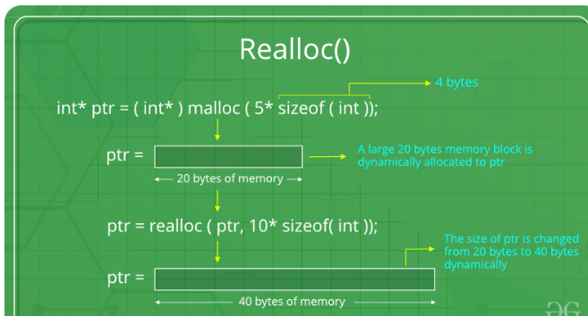
Concept of Dynamic Memory Allocation
3) Realloc (): The function realloc () is used to change the size of memory block. It alters the size of the memory block without losing the old data. This is known as reallocation of memory. This function takes two arguments, first is a pointer to the block of memory that was previously allocated by malloc () or calloc () and second one is the new size for that block. For example: ptr= (int*) realloc (ptr, newsize);

Slide 20
Concept of Dynamic Memory Allocation
4) free () : It is used to free the allocated memory. If dynamically allocated memory is not required anymore, we can free it using the free function. This will free the memory being used by the program in the heap. Syntax : free (ptr)

Slide 21
Introduction to Algorithms
Definition -A process or set of rules to be followed in calculations or other problem-solving operations by a computer is called an algorithm.
Q:- What is a good algorithm? Ans:- An algorithm is called good if it contains the following characteristics; Input: An algorithm should have zero or more stated inputs. Output: An algorithm should produce the desired output. Precision: The number of steps in an algorithm should be precisely defined (stated). Uniqueness: The results of each step are uniquely defined and only depend on input. Fitness: The algorithm should stop after executing a finite no. of steps. Effective: Each step in the algorithm should be effective.

Slide 22
Introduction to Algorithms
Different structures used in algorithms: 1) search algorithm to search an item in a data structure. 2) sort algorithm to sort items in a certain order. 3) insert algorithm to insert item in a data structure. 4) update algorithm to update an existing item in a data structure. 5) delete algorithm to delete an existing item from a data structure.

Slide 23
Asymptotic notations and common functions
Algorithm Complexity Suppose x is an algorithm and n is the size of the input data, the time and space used by the algorithm x are the two main factors, that decide the efficiency of x. i) Time factor Time is measured by counting the number of key operations such as comparisons in the sorting algorithm.
ii) Space factor Space is measured by counting the maximum memory space required by the algorithm. The complexity of an algorithm f(n) gives the running time and/or the storage space required by the algorithm in terms of n as the size of input data.

Slide 24
Asymptotic notations and common functions
1) Space Complexity The Space complexity of an algorithm represents the amount of memory space required by the algorithm in its life cycle. The space required by an algorithm is equal to the sum of the following two components. i) A fixed part that is a space required to store certain data and variables, that are independent of the size of the problem. For example, simple variables and constants used, program size, etc. ii) A variable part is a space required by variables, whose size depends on the size of the problem. For example, dynamic memory allocation, recursion stack space, etc. Space complexity S(P) of any algorithm P is S(P)= C+SP(I), where C is the fixed part and S(I) is the variable part of the algorithm, which depends on instance characteristic I. Following is a simple example that tries to explain the concept.

Slide 25
Asymptotic notations and common functions
Algorithm: SUM (A,B) step1----- START step2----- C A+B+10 step3----- stop Here, we have three variables A, B, and C, and one constant 10. Hence S(P)=1+3. Now, space depends on data types of given variables and constant types and it will be multiplied accordingly.

Slide 26
Asymptotic notations and common functions
2) Time Complexity Time complexity of an algorithm represents the amount of time required by the algorithm to run to completion. Time required can be defined as a numeral function T(n), where T(n) can be measured as the number of steps, provided each step consumes constant time. For example, the addition of two n-bit integers takes n steps. Consequently, the total computational time is T(n)= c*n, where c is the time taken for the addition of two bits. Here, we observe that T(n) grows linearly as the input size increases. 3) Asympotatic analyses and asympotatic notations Asympotatic analysis; of its run time performance. Using asymmetric analysis, we can very well conclude the best-case, average-case, and worst-case scenario of an algorithm. Usually, the time required by the algorithm. Falls under three types:-

Slide 27
Asymptotic notations and common functions
i) Best case Minimum time required for program execution. ii) Average case Average time required for program execution. Iii) Worst case Maximum time required for program execution. Asymptotic Notations: The following are the commonly used asymptotic notations to calculate the running time complexity of an algorithm. * Big Oh Notation, O *Omega Notation, Ω * Theta Notation, θ

Slide 28
Asymptotic notations and common functions
How to find the time complexity?
Method 1: Examine the exact running time
Pick up some machine and turn the timer on. Run the operation for different inputs on the data structures you want to compare one by one and see how much time a particular operation will take on their data structures. The one who takes less time is the best performer.
Problem with this approach:
-It might be possible that for some input sizes, the first data structure gives the best performance and for the other input size, the second gives the best performance.
- It might also be possible that in some machines for some input size of data structure, it is performing well while in the other machine, the second data structure is performing well with a different size.
The exact running time calculation is not at all practical. So, examining the exact running time is not the best solution to calculate the time complexity.

Slide 29
Asymptotic notations and common functions
Measuring the actual running time is not practical at all. The running time generally depends on the size of the input. Suppose we have an array that consist of three elements like this:
We want to add one more element to the beginning of the list. For this purpose, I must have an empty slot here. And I need to make three shifts. If one shift takes 1 unit of time then 3 shifts will take 3 units of time and then I can add the element to the beginning of the list. There is no problem is adding this element.
But what if we have 10000 elements in an array? Isn’t that going to be very tedious? In this case, we have to make 10000 shifts which will take 10000 units of time.
This clearly shows that the running time generally depends on the size of the input. Therefore, if the size of the input is n, then f(n) is a function of n denotes the time complexity.
5 | 4 | 3
5 | 4 | 3
2

Slide 30
Asymptotic notations and common functions
f(n) represents the number of instructions executed for the input value n.
For example:
for(i=0;;<n; i++){
printf(“hello world”);
}
Assuming, this instruction will take 1 unit of time..Printf instruction is executed n number of times. That is why it depends on the size of the input n and f(n) will be equal to n because f(n) is keeping the count of the number of instructions.
Therefore, f(n) = n

Slide 31
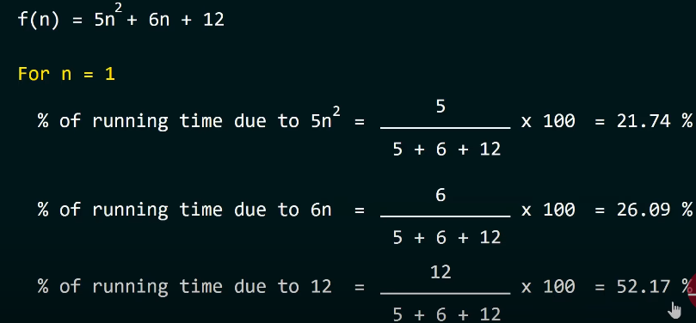
Asymptotic notations and common functions
How to find f(n) ?
Finding f() in a small program is easy. But, as programs become more complex, finding f(n) is not that easy.
We can compare two data structures for a particular operation by comparing their f(n) values.
We are interested in growth rate of f(n) with respect to n because it might be possible that for smaller input size, one data structure may seem better than another but for a larger input size it may not.
This concept is applied in comparing the two algorithms as well.
How to know the growth rate of f(n) ?
Let’s consider one example:

Slide 32
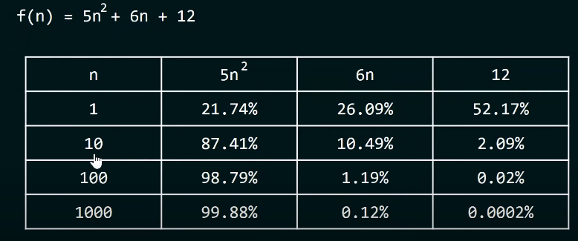
Asymptotic notations and common functions
For growth rate of n , it should be:
If we are increasing n value, we can see 5n² is taking 99.88 % of the time. While 6n is taking 0.12 % of the time and 12 is just taking 0.0002 percent of the time. These are almost negligible.

Slide 33
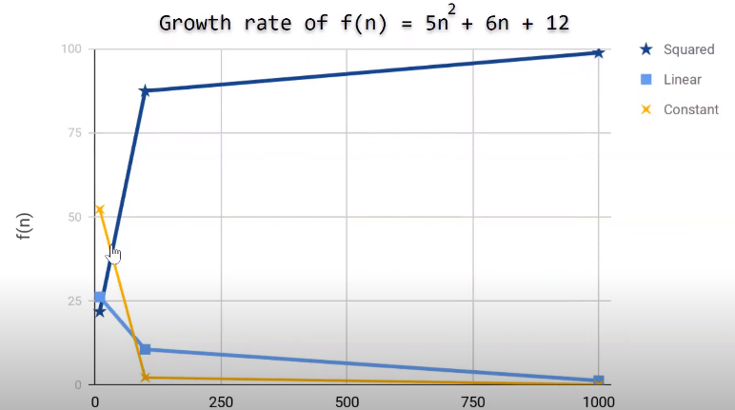
Asymptotic notations and common functions

Slide 34
Asymptotic notations and common functions
So, there is no harm if we eliminate the rest of the terms as they are not contributing much to the time.
F(n) = 5n²
We are getting the approximate time complexity and we are satisfied with this result because this approximate result is very near to the actual result.
This approximate measure of the time complexity is called Asymptotic Complexity.

Slide 35
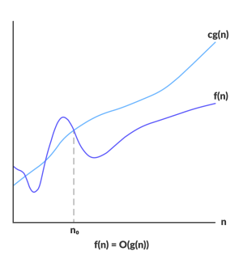
Asymptotic notations and common functions
Big-O notation:Big-O notation represents the upper bound of the running time of an algorithm. Thus, it gives the worst-case complexity of an algorithm.
O(g(n)) = { f(n): there exist positive constants c and n₀ such that 0 ≤ f(n) ≤ cg(n) for all n ≥ n₀ }
The above expression can be described as a function f(n) belongs to the set O(g(n)) if there exists a positive constant c such that it lies between 0 and cg(n), for sufficiently large n.
For any value of n, the running time of an algorithm does not cross the time provided by O(g(n)).
Since it gives the worst-case running time of an algorithm, it is widely used to analyze an algorithm as we are always interested in the worst-case scenario.

Slide 36
Asymptotic notations and common functions
Big Oh Notations (denoted by O) : There are different Big O expressions such as O(1), O(logn), O(n), O(2^{n}), O(nlogn), O (n²) and O(n³) and the time taken that is number of steps when problem size increase can be summarized in the following table :
logn | n | nlogn | n² | n³ | 2^{n}
0 | 1 | 0 | 1 | 1 | 2
1 | 2 | 2 | 4 | 8 | 4
2 | 4 | 8 | 16 | 64 | 16
3 | 8 | 24 | 64 | 512 | 256
4 | 16 | 64 | 256 | 4096 | 65536
5 | 32 | 160 | 1024 | 32768 | 4294967296
Note: O(1)<O(logn),<O(n)<O(nlogn)<O (n²)<O(n³)< O(2^{n})

Slide 37
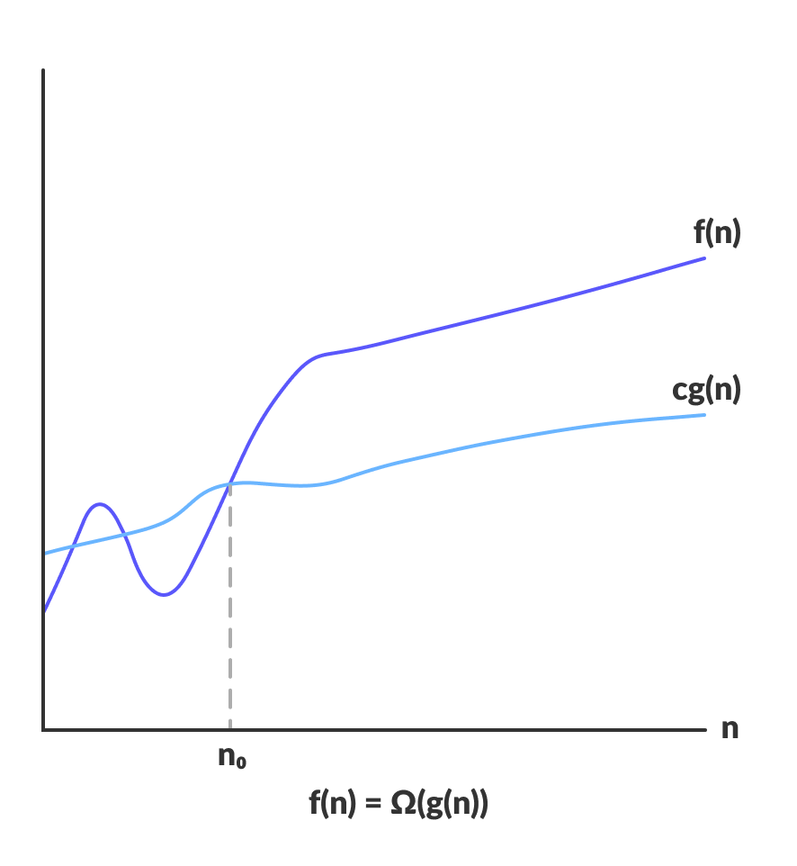
Asymptotic notations and common functions
Omega Notation (Ω-notation) Omega notation represents the lower bound of the running time of an algorithm. Thus, it provides the best case complexity of an algorithm.
O(g(n)) = { f(n): there exist positive constants c and n₀ such that 0 ≤ cg(n) ≤ f(n) for all n ≥ n₀ }
The above expression can be described as a function f(n) belongs to the set Ω(g(n)) if there exists a positive constant c such that it lies above cg(n), for sufficiently large n.
For any value of n, the minimum time required by the algorithm is given by Omega Ω(g(n)).

Slide 38
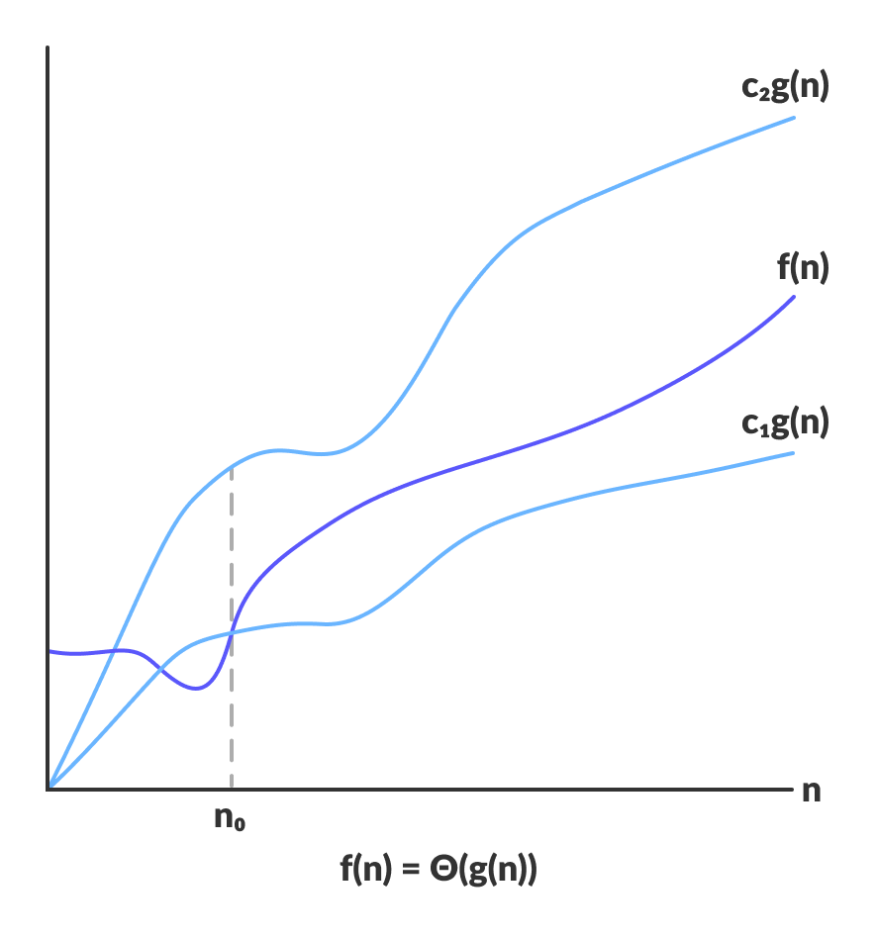
Asymptotic notations and common functions
Theta Notation (Θ-notation) Theta notation encloses the function from above and below. Since it represents the upper and the lower bound of the running time of an algorithm, it is used for analyzing the average-case complexity of an algorithm.
Θ(g(n)) = { f(n): there exist positive constants c₁, c₂ and n₀ such that 0 ≤ c₁g(n) ≤ f(n) ≤ c₂g(n) for all n ≥ n₀ }
The above expression can be described as a function f(n) belongs to the set Θ(g(n)) if there exist positive constants c₁ and c₂ such that it can be sandwiched between c₁g(n) and c₂g(n), for sufficiently large n.
If a function f(n) lies anywhere in between c₁g(n) and c₂g(n) for all n ≥ n0, then f(n) is said to be asymptotically tight bound.

Slide 39
Asymptotic notations and common functions
Example 1: f(n)=2n+3 , g(n)=n
Now, we have to find Is f(n)=O(g(n))?
To check f(n)=O(g(n)), it must satisfy the given condition:
f(n)<=c.g(n)
First, we will replace f(n) by 2n+3 and g(n) by n.
2n+3 <= c.n
Let's assume c=5, n=1 then
2*1+3<=5*1
5<=5
For n=1, the above condition is true.
If n=2
2*2+3<=5*2
7<=10
For n=2, the above condition is true.
We know that for any value of n, it will satisfy the above condition, i.e., 2n+3<=c.n. If the value of c is equal to 5, then it will satisfy the condition 2n+3<=c.n. We can take any value of n starting from 1, it will always satisfy. Therefore, we can say that for some constants c and some constants n0, it will always satisfy 2n+3<=c.n. As it satisfies the above condition, so f(n) is big oh of g(n) or we can say that f(n) grows linearly.

Slide 40
Asymptotic notations and common functions
Example 1: f(n)=2n+3 , g(n)=n
Now, we have to find Is f(n)=O(g(n))?
To check f(n)=O(g(n)), it must satisfy the given condition:
f(n)<=c.g(n)
First, we will replace f(n) by 2n+3 and g(n) by n.
2n+3 <= c.n
Let's assume c=5, n=1 then
2*1+3<=5*1
5<=5
For n=1, the above condition is true.
If n=2
2*2+3<=5*2
7<=10
For n=2, the above condition is true.
We know that for any value of n, it will satisfy the above condition, i.e., 2n+3<=c.n. If the value of c is equal to 5, then it will satisfy the condition 2n+3<=c.n. We can take any value of n starting from 1, it will always satisfy. Therefore, we can say that for some constants c and some constants n0, it will always satisfy 2n+3<=c.n. As it satisfies the above condition, so f(n) is big oh of g(n) or we can say that f(n) grows linearly.

